Slide 1
Flight Booking App Using MERN Stack
Team Members:
Kishore Kumar K
Kiruthik P
Manikandan U
Kutti Pillai K.M
Inbarasu R.M

Slide 2
Abstract:
This project aims to develop a comprehensive and user-friendly flight booking application using the MERN (MongoDB, Express.js, React, and Node.js) stack. The application provides a seamless platform for users to search, book, and manage flight reservations.
front-end features of React, this app ensures a smooth user experience across devices.
MongoDB serves as the database, allowing efficient storage and retrieval of flight details, user information, and booking records. Additional features include real-time flight availability, secure payment integration, and user authentication to safeguard personal data.

Slide 3
Introduction:
In today’s digital age, the demand for online services is growing rapidly, with travel and tourism being one of the key sectors undergoing significant transformation. The need for efficient and reliable flight booking systems is more essential than ever, as travelers seek convenience and flexibility. This project focuses on building a fully-functional flight booking application using the MERN stack, which includes MongoDB, Express.js, React, and Node.js.
The MERN stack is widely recognized for its ability to build high-performance web applications. By utilizing this technology stack, the application offers a full-stack solution with a modern, responsive front-end and a robust back-end, providing users with features such as flight searches, real-time availability, seat selection, and secure payment options. The application is designed to deliver a seamless experience, ensuring user satisfaction while maintaining data security and scalability.

Slide 4
Proposed System:
The proposed flight booking system is a web-based platform built using the MERN stack, designed to simplify the flight reservation process for users. This system will allow users to search for flights, view available options, select flights, book tickets, and securely make payments—all in one integrated application. The system is scalable, reliable, and optimized for performance.
Key Components of the Proposed Systems are Front-End, Back-End, Database, Payment Gateway, User Security and Admin Dashboard.

Slide 5
Front-End Development
The front-end of the flight booking application is built using React.js, focusing on creating a dynamic and responsive user experience. By leveraging reusable components, React enhances development speed and design consistency. The application is fully responsive, ensuring compatibility across devices like desktops, tablets, and smartphones.
Key features include a Flight Search Bar for entering travel details, a Flight Listings Page displaying real-time availability and pricing, and an intuitive Seat Selection & Booking interface. Users can manage profiles and view booking histories easily.
State management is implemented with hooks like useState and useEffect, allowing for dynamic data updates and session management. The front-end communicates with the back-end through RESTful APIs for real-time data synchronization.

Slide 6
Back-End Development:
The back-end of the flight booking application is built with Node.js and Express.js, providing a scalable and efficient server-side solution. Node.js facilitates fast handling of client requests, while Express.js simplifies the creation of RESTful APIs for flight searches, bookings, and user authentication. MongoDB serves as the NoSQL database, storing flight details and user profiles securely. User data is protected using JWT (JSON Web Tokens) for authentication, and sensitive information is safeguarded with password hashing.
The back-end also integrates the payment gateways for secure transactions and employs robust error handling and logging to monitor performance and manage issues. Overall, this back-end architecture ensures a secure and efficient framework for the flight booking application.

Slide 7
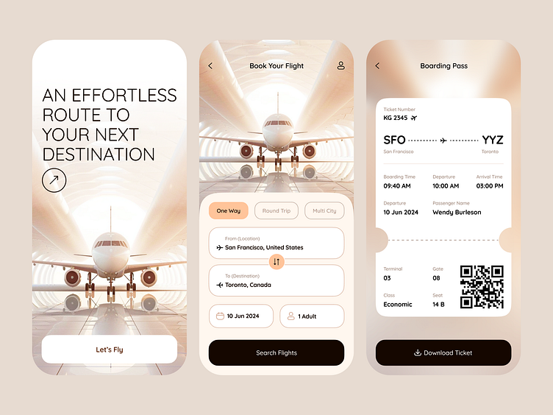
Model:

Slide 8
Conclusion:
The Flight Booking App developed with the MERN stack provides a user-friendly platform for managing flight reservations. By leveraging MongoDB, Express.js, React.js, and Node.js, the app ensures seamless interaction and an efficient user experience.
It features real-time flight searches, secure payment processing, and user account management across devices, with a strong emphasis on security through robust authentication and data protection measures.
This project not only demonstrates the practical use of the MERN stack but also highlights potential for future enhancements, making it a modern solution for travelers in the industry.

Slide 9
THANK YOU !

